Slide 1

Sync+ 2.0
Phase4_CX727ICA_R04 –Baidu
Baidu
Updated on 2022-06-20
Desired Outcome
Awareness
Decision
Escalation Help
Think
Point of view
Plan to Implement
Implement

Slide 2
{CX727ICA R04 PRO} Software overall status {green}
Software key info
Refer SWAD for the details:
MCU version: 20220411_426_PRO
SoC User version: 20220416_0669_JF15_R04.ENG
Verification scope and method:
{Full verification} executed with pass rate 96%. Refer test report for detail.
Main changes compared with previous version, refer RN for the details, highlights listed below:
Open IG issue list with risk evaluation：0 issue
Open AMIS issue list with risk evaluation：0 issues
Memory leak test result and voice test result– refer slide 3、4 、5
Performance test result – refer slide 6
Notes:
Add P1 weekly burn down chart

Slide 3
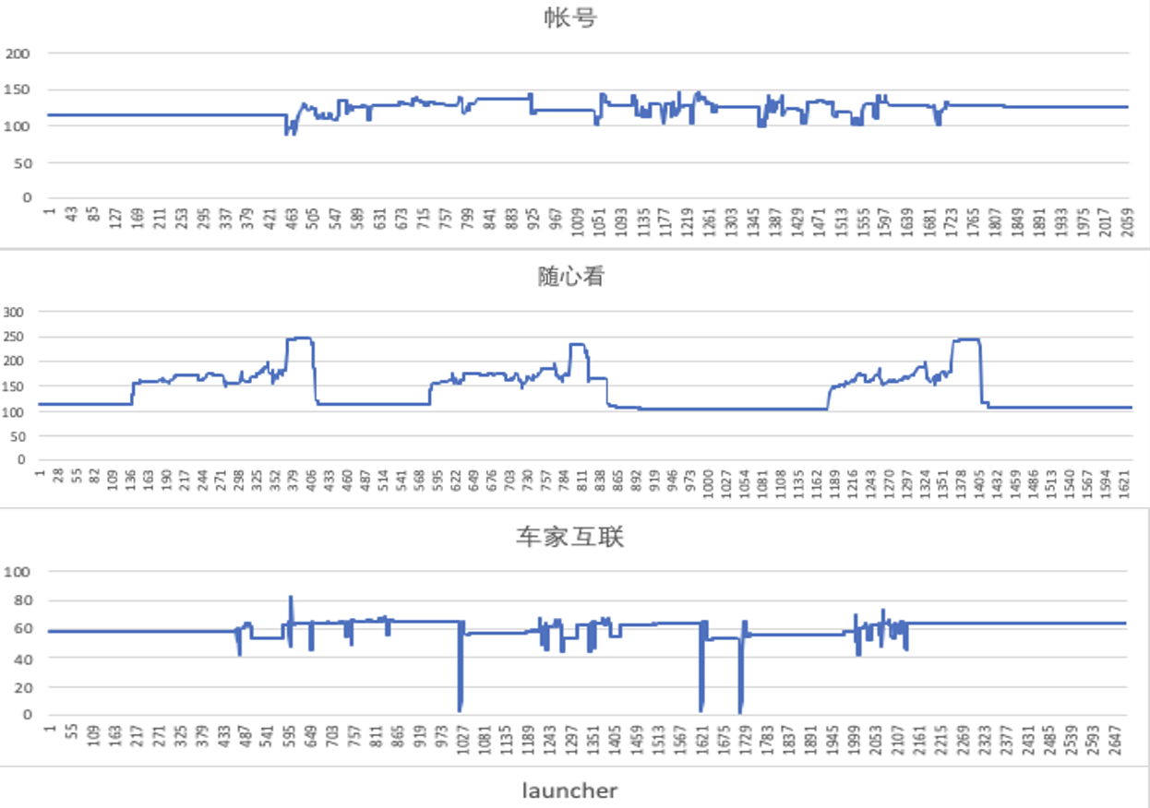
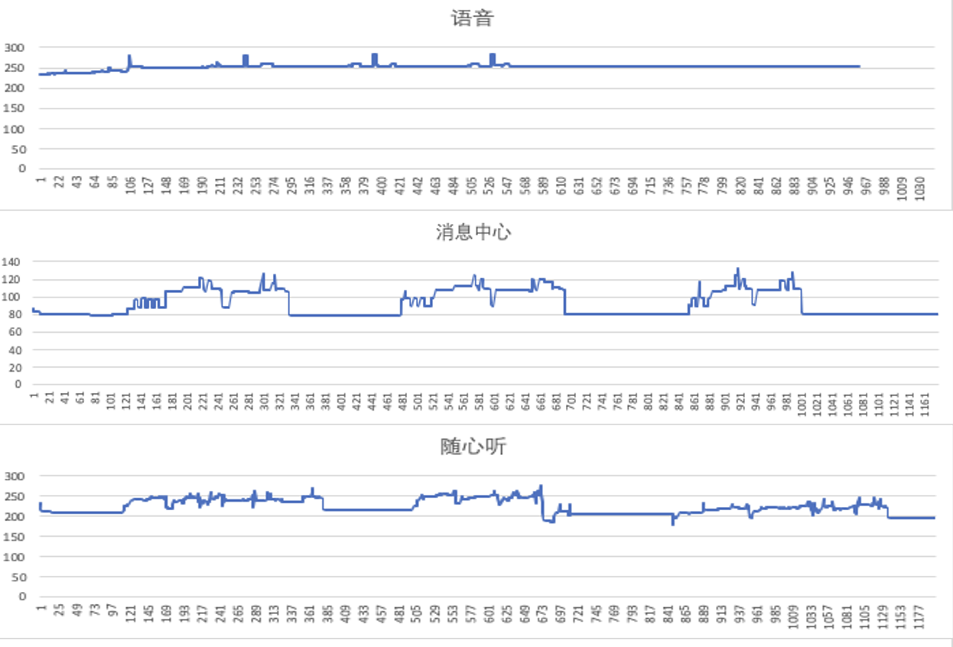
{CX727ICA R04 PRO} 内存泄漏专项测试

Slide 4
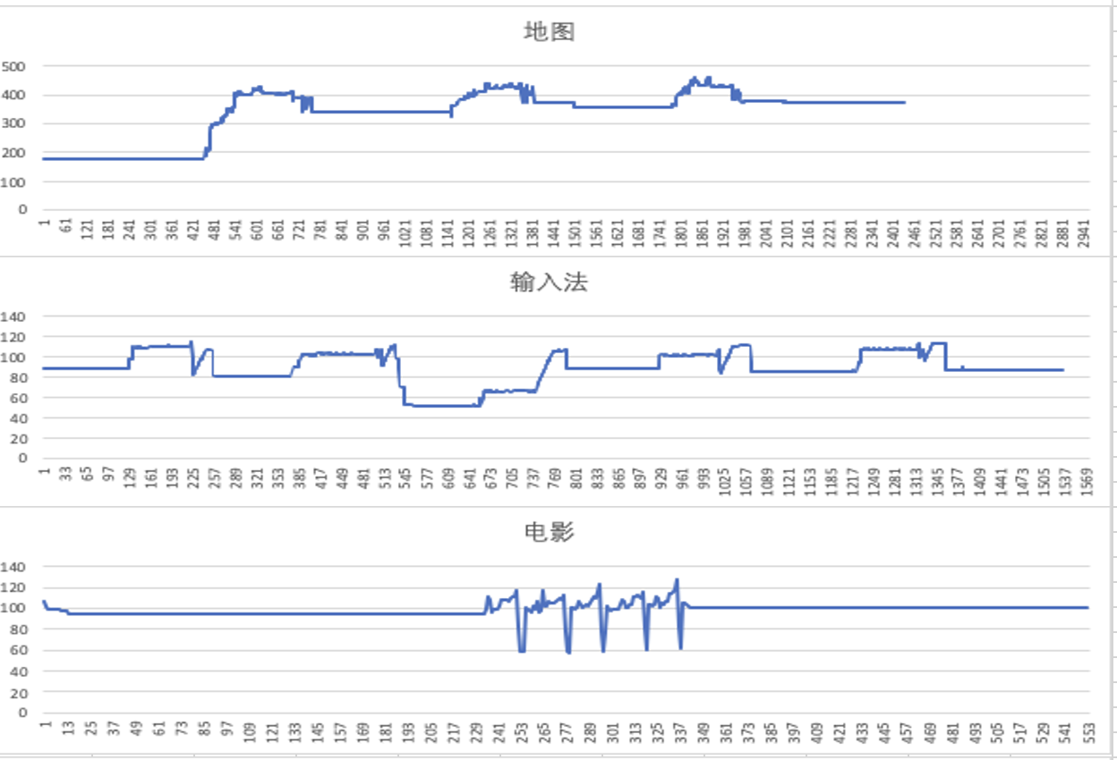
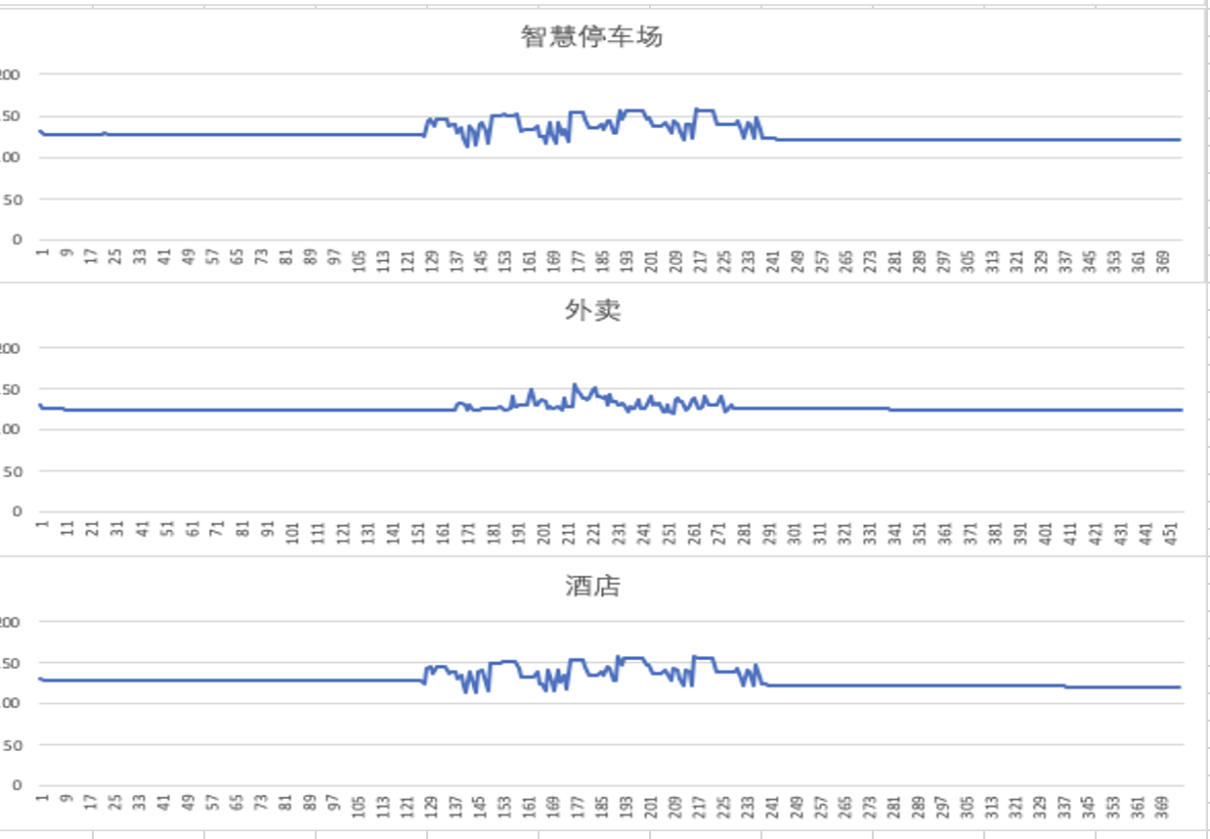
{CX727ICA R04 PRO} 内存泄漏专项测试

Slide 5
{CX727ICA R04 PRO} 语音专项测试
唤醒词唤醒率：高配、低配 Pass
唤醒词唤醒率：高配、低配 Pass
场景化命令词识别率
AI能力 | 指标项 | 通过标准 | 测试次数 | 实测结果 | 测试结论
暂停播放 | 低噪 | 85% | 10次 | 98% | PASS
 | 中噪 | 85% | 10次 | 100% | PASS
 | 高噪 | 80% | 10次 | 94% | PASS
继续播放 | 低噪 | 85% | 10次 | 96% | PASS
 | 中噪 | 85% | 10次 | 100% | PASS
 | 高噪 | 80% | 10次 | 96% | PASS
上一首 | 低噪 | 85% | 10次 | 100% | PASS
 | 中噪 | 85% | 10次 | 98% | PASS
 | 高噪 | 80% | 10次 | 100% | PASS
上一曲 | 低噪 | 85% | 10次 | 98% | PASS
 | 中噪 | 85% | 10次 | 100% | PASS
 | 高噪 | 80% | 10次 | 92% | PASS
下一首 | 低噪 | 85% | 10次 | 98% | PASS
 | 中噪 | 85% | 10次 | 92% | PASS
 | 高噪 | 80% | 10次 | 96% | PASS
下一曲 | 低噪 | 85% | 10次 | 98% | PASS
 | 中噪 | 85% | 10次 | 100% | PASS
 | 高噪 | 80% | 10次 | 96% | PASS
接听电话 | 低噪 | 85% | 10次 | 98% | PASS
 | 中噪 | 85% | 10次 | 98% | PASS
 | 高噪 | 84% | 10次 | 97% | PASS
挂断电话 | 低噪 | 84% | 10次 | 97% | PASS
 | 中噪 | 84% | 10次 | 97% | PASS
 | 高噪 | 84% | 10次 | 97% | PASS
场景化命令词识别率
AI能力 | 指标项 | 通过标准 | 测试次数 | 实测结果 | 测试结论
跟随模式 | 低噪 | 85% | 10次 | 96% | PASS
 | 中噪 | 85% | 10次 | 100% | PASS
 | 高噪 | 80% | 10次 | 96% | PASS
车头朝上 | 低噪 | 85% | 10次 | 96% | PASS
 | 中噪 | 85% | 10次 | 100% | PASS
 | 高噪 | 80% | 10次 | 100% | PASS
正北模式 | 低噪 | 85% | 10次 | 100% | PASS
 | 中噪 | 85% | 10次 | 98% | PASS
 | 高噪 | 80% | 10次 | 100% | PASS
放大地图 | 低噪 | 85% | 10次 | 98% | PASS
 | 中噪 | 85% | 10次 | 98% | PASS
 | 高噪 | 80% | 10次 | 90% | PASS
缩小地图 | 低噪 | 85% | 10次 | 100% | PASS
 | 中噪 | 85% | 10次 | 100% | PASS
 | 高噪 | 80% | 10次 | 98% | PASS
打开路况 | 低噪 | 85% | 10次 | 98% | PASS
 | 中噪 | 85% | 10次 | 100% | PASS
 | 高噪 | 80% | 10次 | 100% | PASS
关闭路况 | 低噪 | 85% | 10次 | 100% | PASS
 | 中噪 | 85% | 10次 | 100% | PASS
 | 高噪 | 80% | 10次 | 98% | PASS
开始导航 | 低噪 | 85% | 10次 | 98% | PASS
 | 中噪 | 85% | 10次 | 100% | PASS
 | 高噪 | 80% | 10次 | 98% | PASS
场景化命令词识别率
AI能力 | 指标项 | 通过标准 | 测试次数 | 实测结果 | 测试结论
查看全程 | 低噪 | 85% | 10次 | 98% | PASS
 | 中噪 | 85% | 10次 | 100% | PASS
 | 高噪 | 80% | 10次 | 98% | PASS
继续导航 | 低噪 | 85% | 10次 | 100% | PASS
 | 中噪 | 85% | 10次 | 100% | PASS
 | 高噪 | 80% | 10次 | 96% | PASS
上一页 | 低噪 | 85% | 10次 | 92% | PASS
 | 中噪 | 85% | 10次 | 92% | PASS
 | 高噪 | 80% | 10次 | 96% | PASS
下一页 | 低噪 | 85% | 10次 | 100% | PASS
 | 中噪 | 85% | 10次 | 100% | PASS
 | 高噪 | 80% | 10次 | 94% | PASS
确定 | 低噪 | 85% | 10次 | 96% | PASS
 | 中噪 | 85% | 10次 | 94% | PASS
 | 高噪 | 80% | 10次 | 100% | PASS
取消 | 低噪 | 85% | 10次 | 98% | PASS
 | 中噪 | 85% | 10次 | 100% | PASS
 | 高噪 | 80% | 10次 | 100% | PASS
第一个 | 低噪 | 85% | 10次 | 92% | PASS
 | 中噪 | 85% | 10次 | 85% | PASS
 | 高噪 | 80% | 10次 | 90% | PASS
第二个 | 低噪 | 85% | 10次 | 90% | PASS
 | 中噪 | 85% | 10次 | 86% | PASS
 | 高噪 | 80% | 10次 | 86% | PASS
第三个 | 低噪 | 85% | 10次 | 86% | PASS
 | 中噪 | 85% | 10次 | 86% | PASS
 | 高噪 | 80% | 10次 | 90% | PASS
唤醒词唤醒率
AI 能力 | 指标项 | 通过标准 | 测试次数 | 实测结果 | 测试结论
小度小度 | 低噪 | 92% | 20次 | 99% | PASS
 | 中噪 | 90% | 20次 | 100% | PASS
 | 高噪 | 85% | 20次 | 100% | PASS
电马同学 | 低噪 | 92% | 20次 | 100% | PASS
 | 中噪 | 90% | 20次 | 100% | PASS
 | 高噪 | 85% | 20次 | 100% | PASS
说明：
唤醒词：小度小度、电马同学，高中低噪，各测20遍；
场景化命令词（上一首、下一曲等），高中低噪，各测10遍；
测试过程中6至8人参与测试

Slide 6
{CX727ICA R04 PRO} 性能专项测试

